Slide 1
BUG BUSTERS
"We squash the glitches so you can shine!"
Our Hackathon Journey

Slide 2
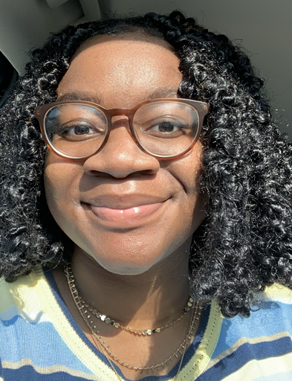
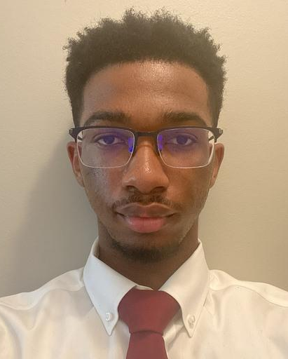
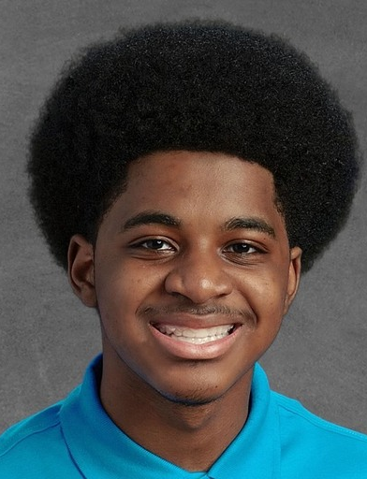
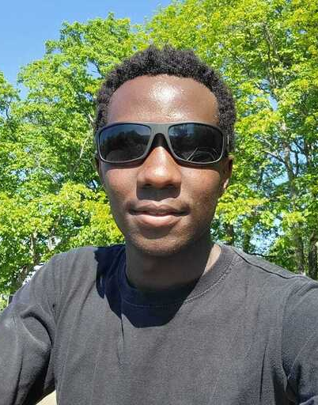
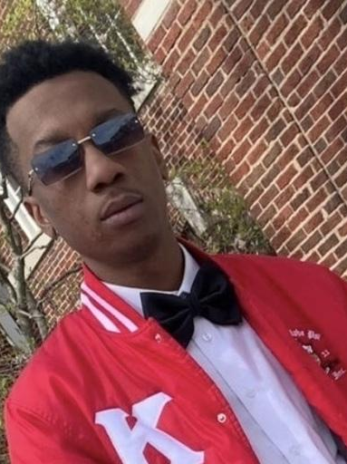
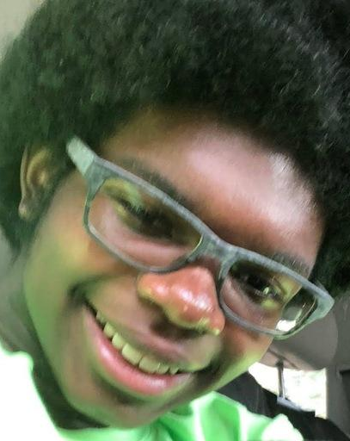
Meet the Team!
Cierrah_
Washington.jpg
Gerrick_
Jones.jpg
Seth_
Mack.jpg
Ronny_
Kiprono.jpg
Yamonta_
Gaines.jpg
Justin_
Davis.jpg

Slide 3
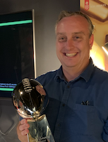
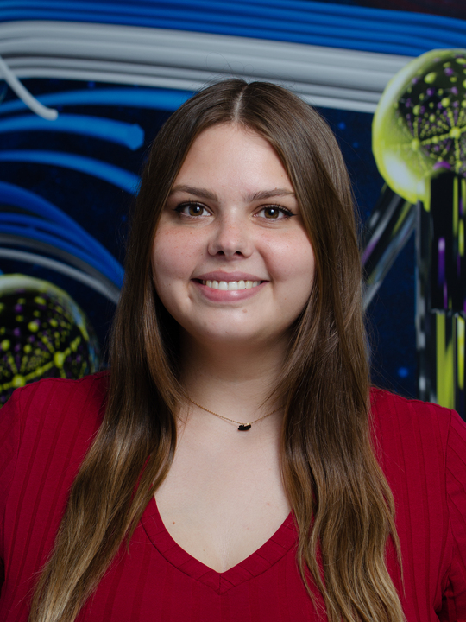
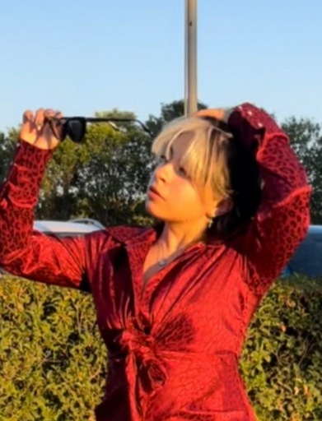
Mentors!
Boyd_Wilson.jpg
Emma_Bukowski.jpg
Josselyn_Salgado.jpg

Slide 4




Resources
HackHPC Events | Provided Ideas and Guides
HackHPC Website | Existing code for new website
HTML CheatSheet | Used to implement specific colors
Hugo | Fast Website Building
Visual Studio Code | Auto-fill & cross-platform support

Slide 5

Complications
Navigating the pre-organized template
Github deployment issues
Reverting changes in github to restore our project
OK
Cancel

Slide 6
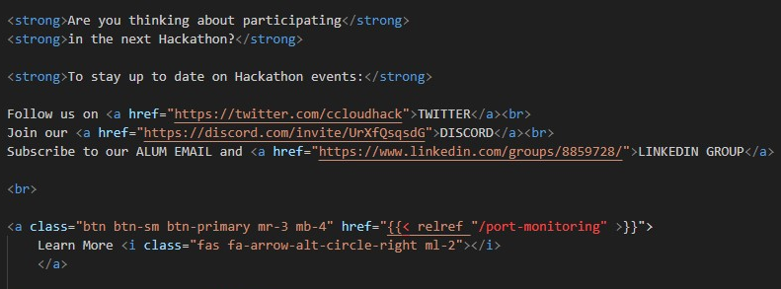
UX Designs/Sample Code
Knowing our target audience is interested in hackathons, we included:
Events tab in the main page header that lead to hackathon resources.
Easy to find buttons that will send the user to the social media accounts.
<< Sample code
Context: Registration block containing links to HackHPC twitter page, discord, and linkedIn profile

Slide 7
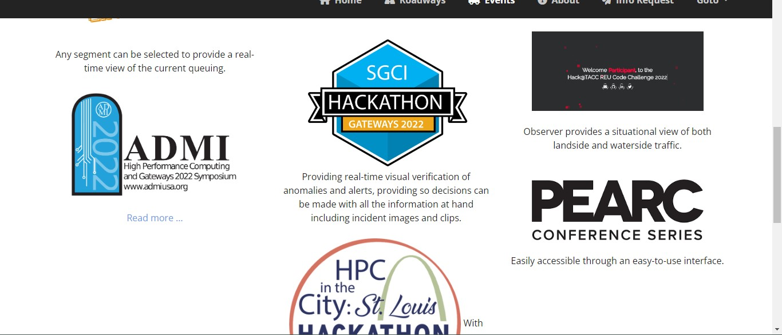
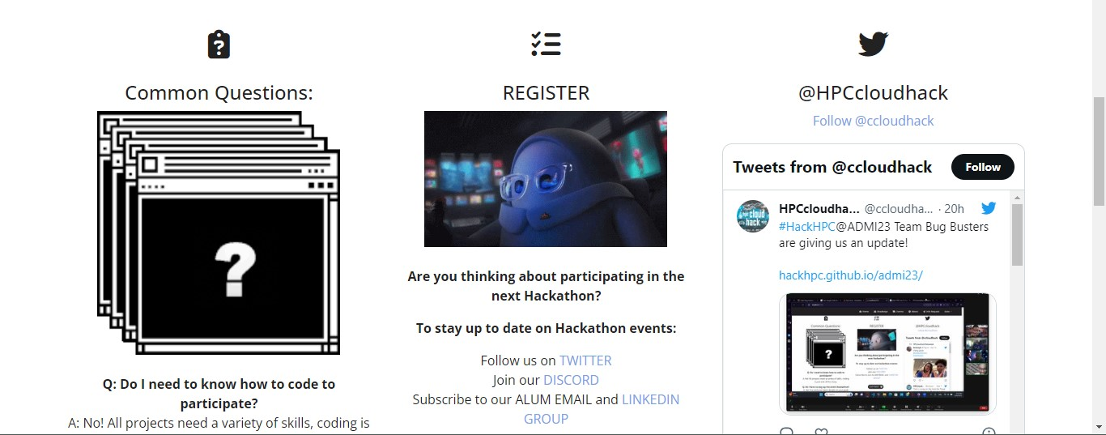
Screen Shots
Past HPC events >>
<<<FAQ and Registration

Slide 8
01
Questions?
??????

